Slide 1

Crop rotation and Sustainable Transport
Group 2 – Amogh, Gokhul, Swaroop, Dipanjana, Shrilekhya, Pragna

Slide 2
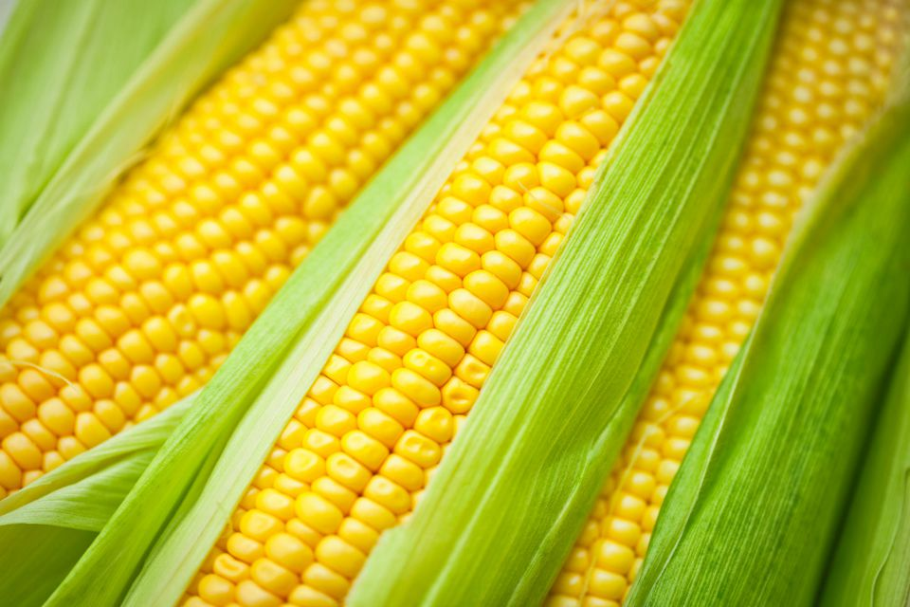
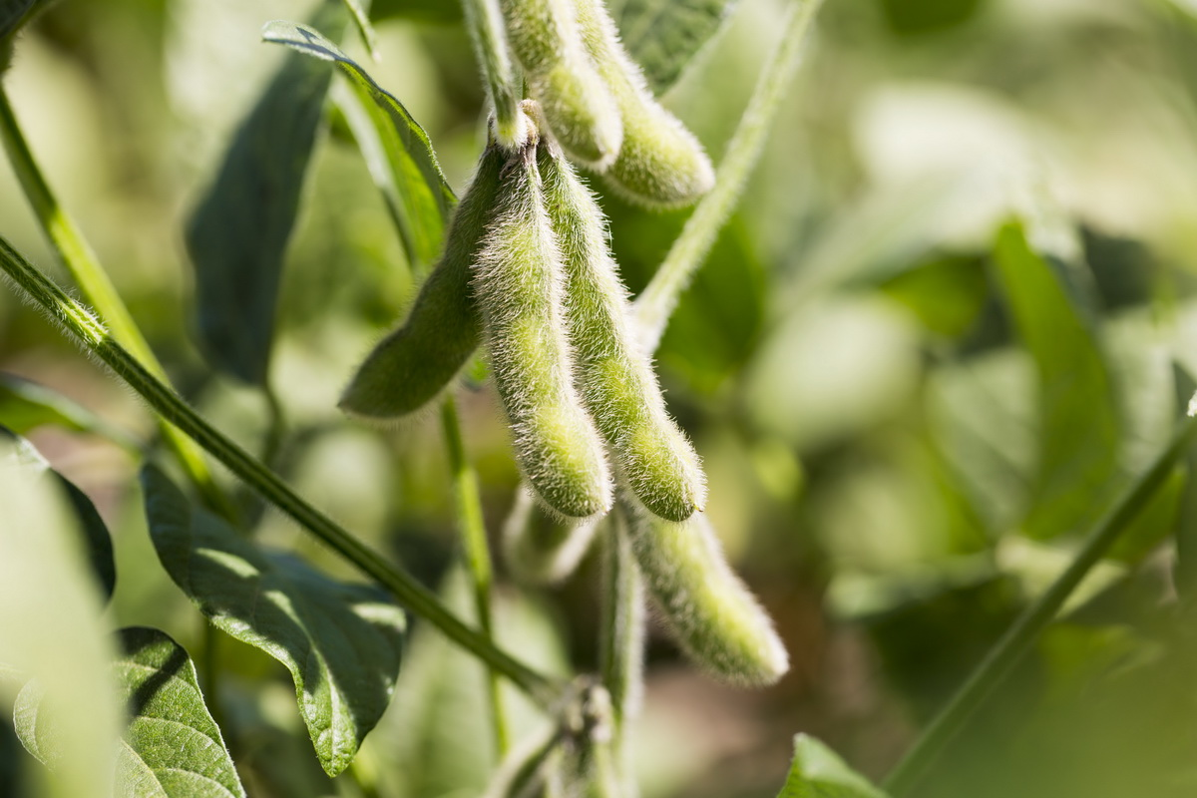

Slide 3
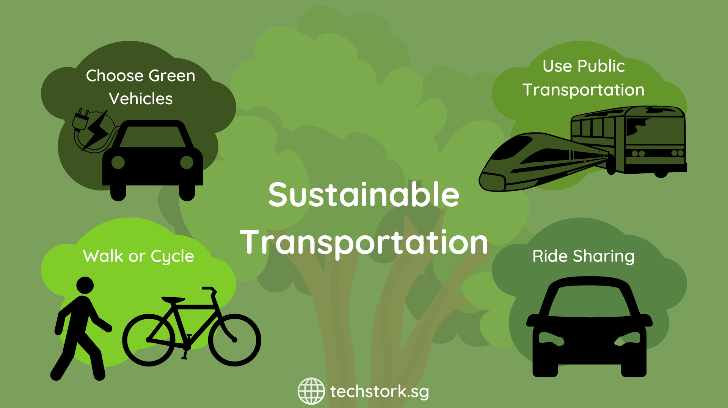

Slide 4
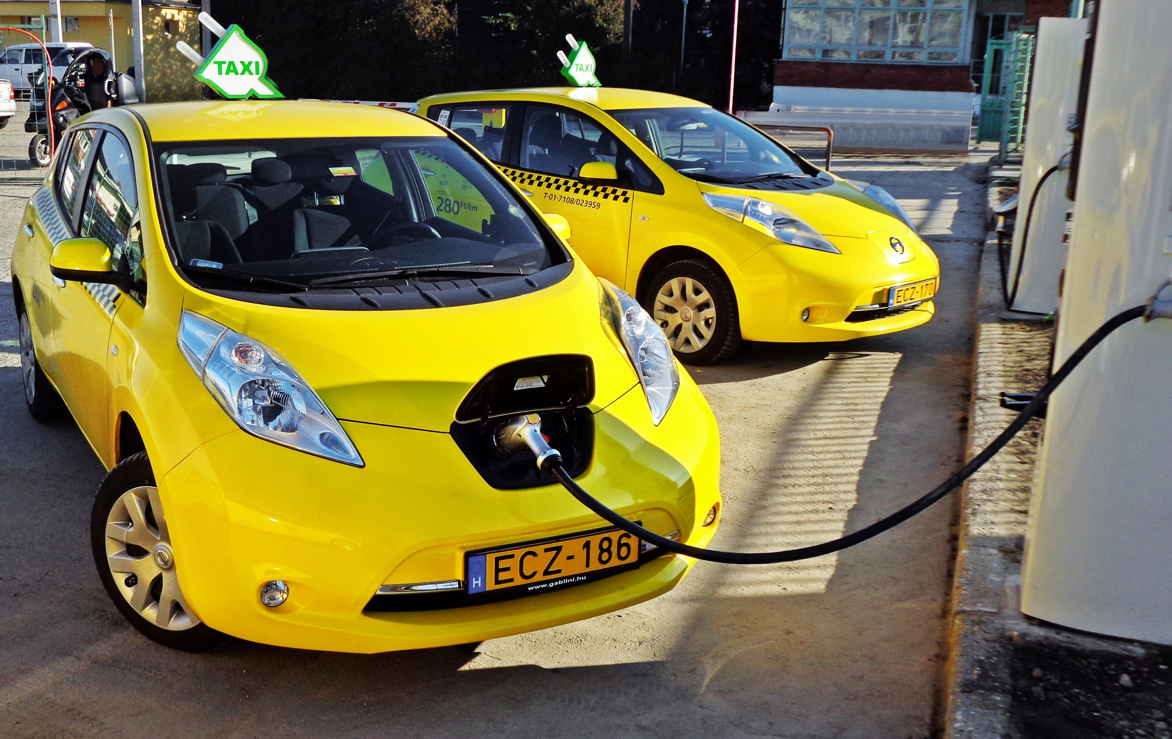
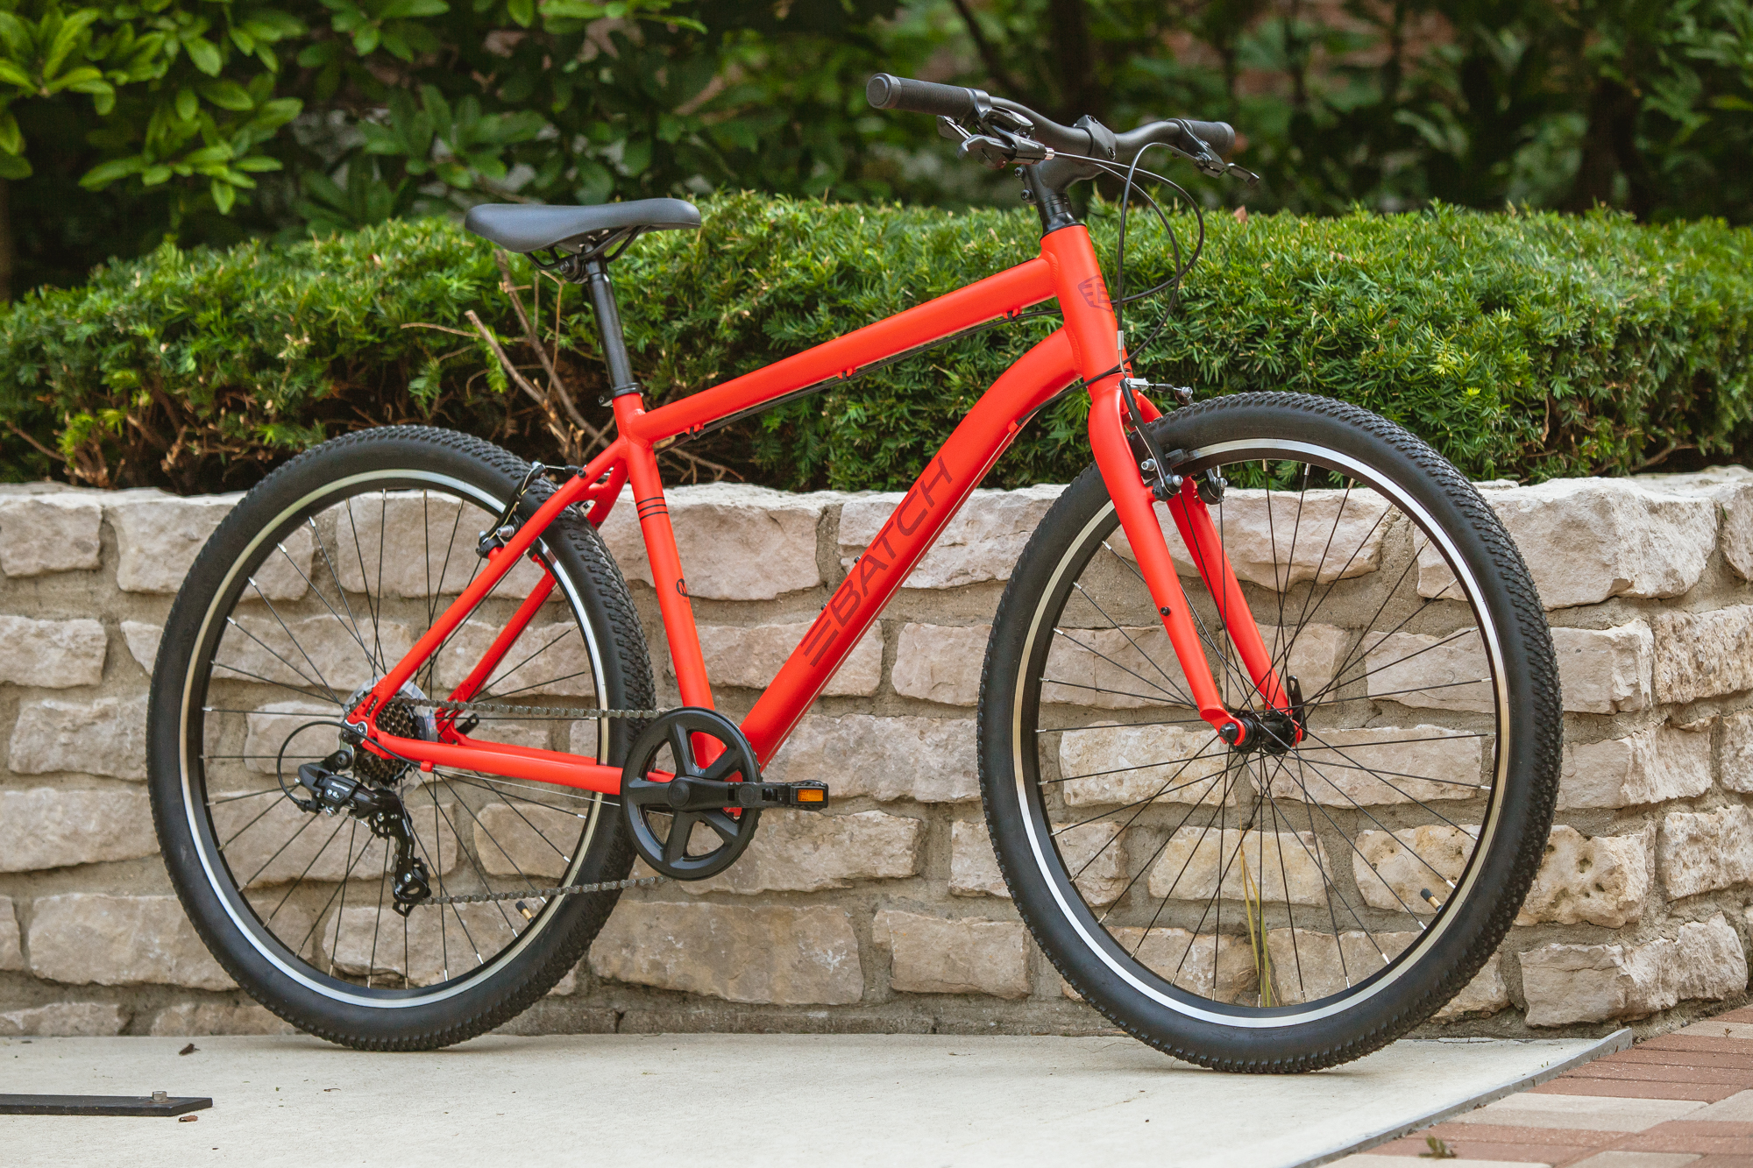
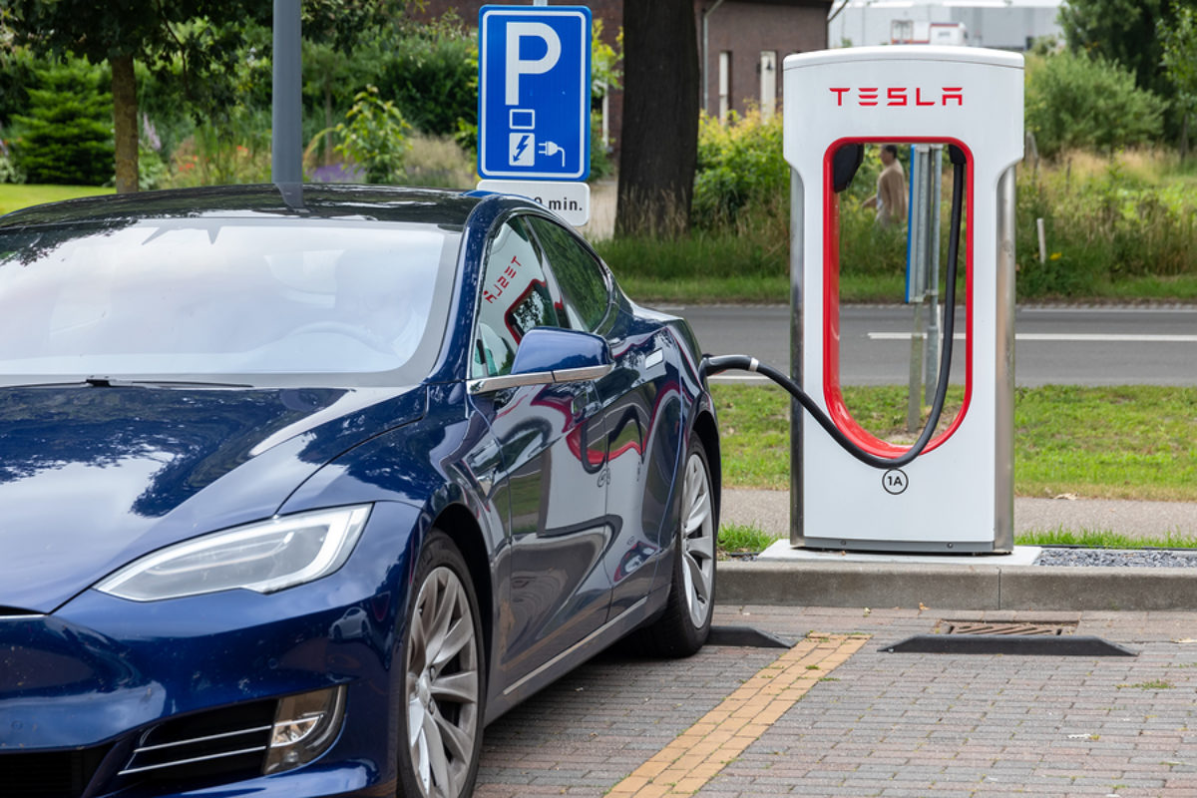

Slide 5
THANK YOU

